Slide 1
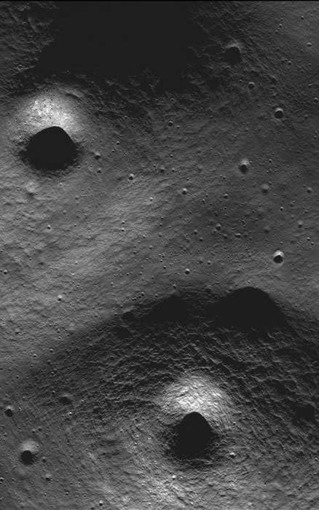
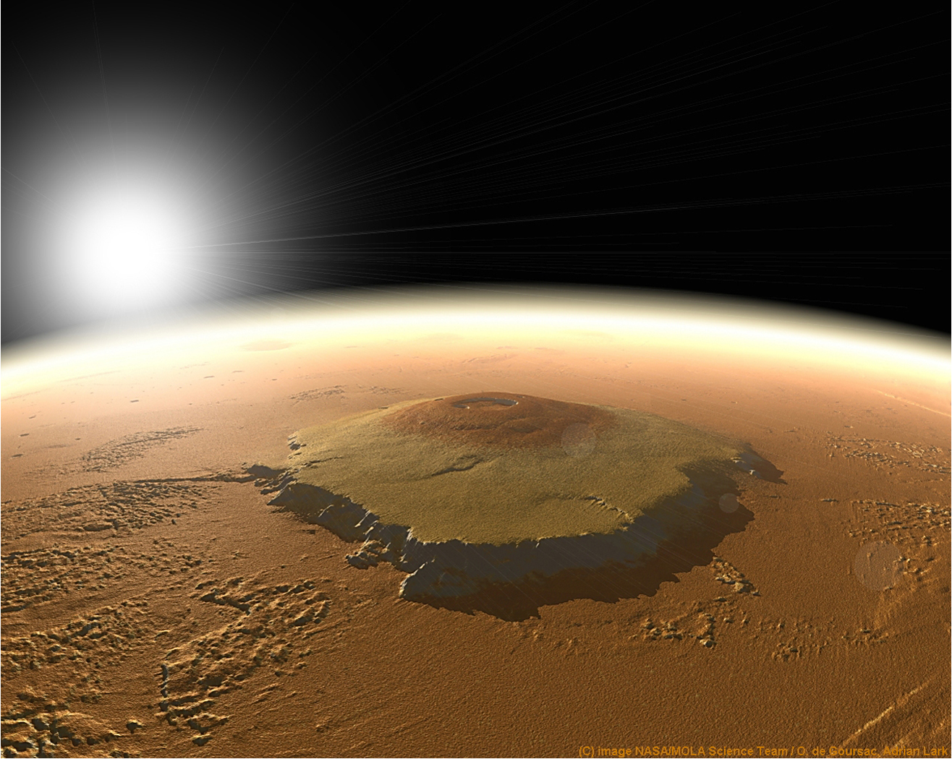
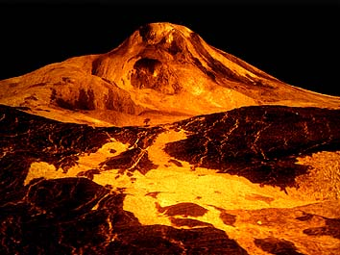
Volcanoes in our
Solar System

Slide 2
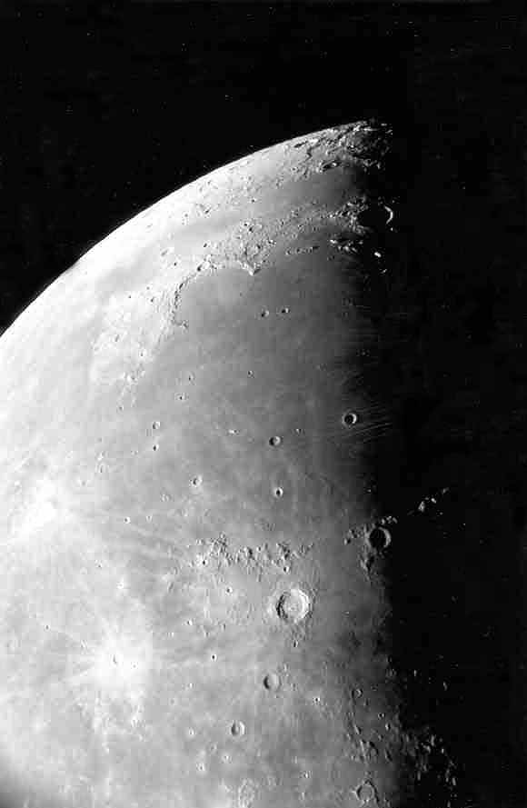
Moon Maré
Moon maria as seen through our telescope.
Photo by
Jim Fullerton

Slide 3
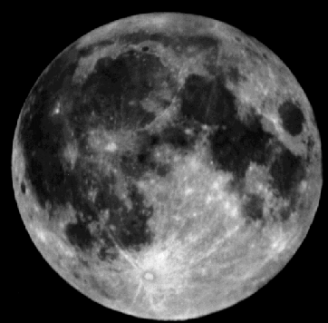
Moon Maré
The maria (maré) are the smooth dark areas on the surface of the Moon.
Mare
Highlands

Slide 4
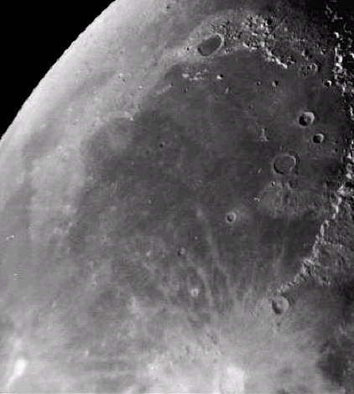
Moon Maré
The maria were formed about 3.5 – 4 billion years ago.
Lava flowed through cracks in the lunar surface and filled in low laying areas. These cracks were NOT developed because of an impact. Scientists are not sure what caused them.
Maré Imbrium

Slide 5
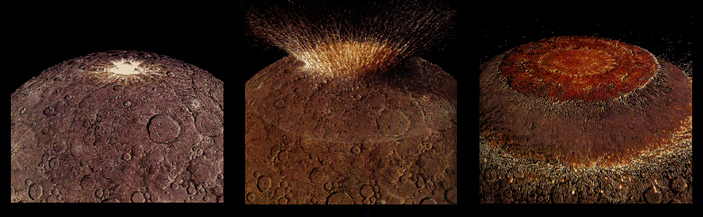
Moon Maré
Four billion years ago the impact of a very large asteroid formed a huge multi-ringed basin which thinned and fractured the lunar crust.

Slide 6
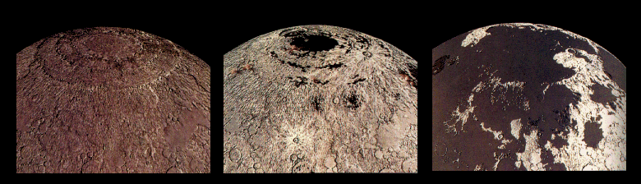
Moon Maré
Thin, lava from beneath the moon’s crust flowed out and flooded the low regions of the lunar surface, filling many existing craters.

Slide 7
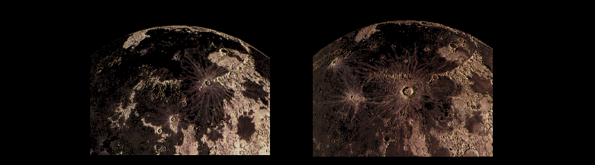
Moon Maré
Less than a billion years after it began, the lava stopped flowing out onto the surface of the Moon and new craters began to form on top of the maria.

Slide 8
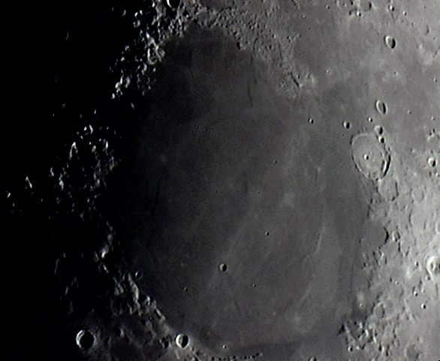
Older & Larger Craters
Mare Imbrium
Mare Serenitatis
Many older, larger craters on the near-side of the Moon have been completely filled with lava – about 31% of the near-side.

Slide 9
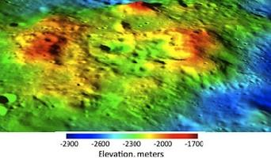
Volcanic Cones?
Rare volcanic cones on the far side of the Moon.
Almost no volcanic cones were created on the Moon because most of the lava had a very different chemical composition than lava on Earth.

Slide 10
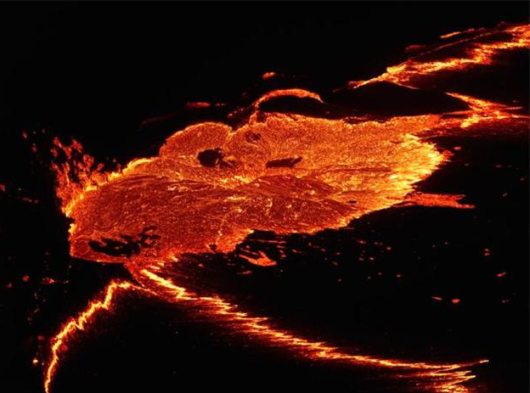
Lunar Volcano
The chemical composition of the Moon’s lava makes it thin so it flows more easily, spreading out evenly so volcanic cones do not form.

Slide 11
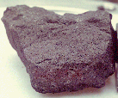
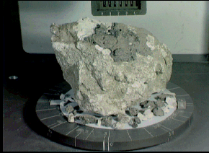
Moon Maré
Lunar rock samples from the moon’s maria are dark colored rocks.
Rock samples from the highland regions are much lighter in color.

Slide 12
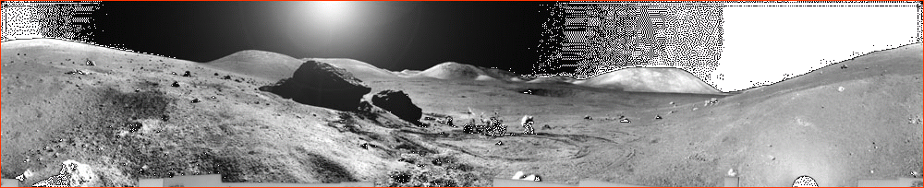
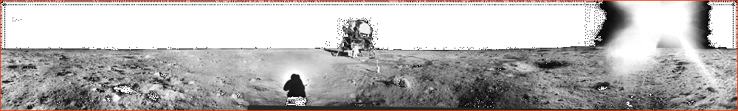
One of these pictures shows the lunar surface from a maré, the other from the highlands.
Can you tell which is which?

Slide 13
Moon Maré
The highlands are rugged.
The maré are relatively smooth and flat.

